Slide 1
Internet Censorship and Online Speech Paid Prioritization
Nick Feamster University of Chicago

Slide 2
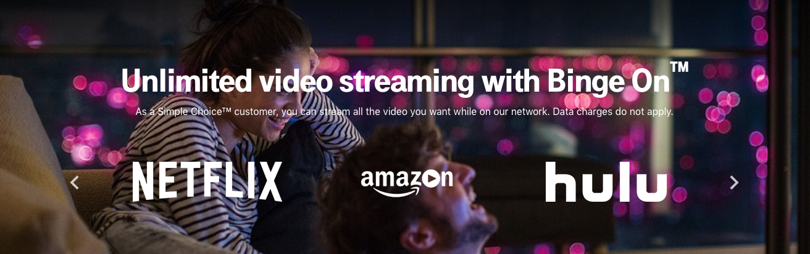
Paid Prioritization and “Zero Rating”

Slide 3
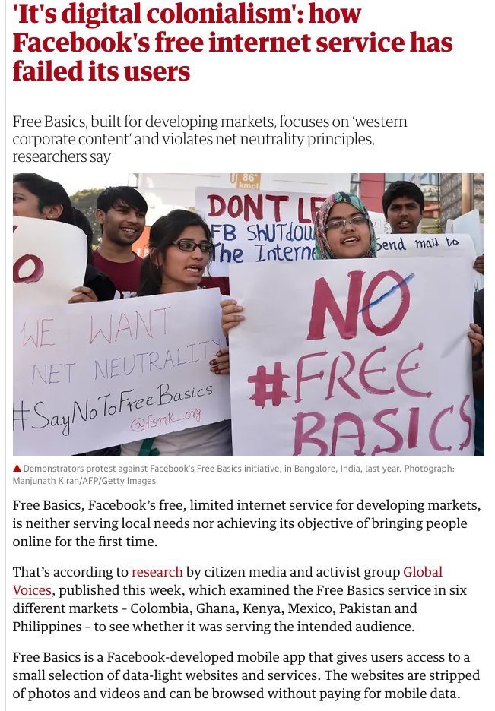
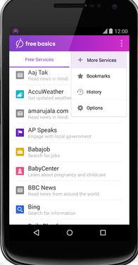
Facebook’s “Free Basics”
User gets access to some subset of applications for free (e.g., BBC News, …) without paying mobile carrier for data charges
Other sites incur regular carrier fees/data charges.

Slide 4
Walled Garden, or Gateway Drug?
Goal
Study mobile usage patterns in the context of pricing practices like zero-rating
Two Aspects:
Net neutrality & walled garden arguments
Connectivity & gateway drug arguments
Notes:
Motivation: analyze empirical relationships between different mobile data pricing practices and mobile data usage patterns, specifically zooming in on behavioral discrepancies between users on different data plans (unlimited vs. prepaid plans) and connection types (wifi vs. cellular). We also take into account practices like zero-rating and prepaid data pricing.
Particularly interested in the increasingly popular practice of zero-rating, which is when a mobile carrier or ISP offers free cellular data access to certain mobile services or applications. (cellular meaning anything 2G/3G/4G/LTE, etc. One big example of zero-rating is Facebook’s Free Basics mobile app offered in many developing countries. The app provides free access to a suite of basic services including health, job, and travel information.)
Net neutrality: carrier/regulator side, carriers should treat all bits of traffic flow equally, giving no priority based on payment to the service provider
Walled garden: consumer-side, zero-rating discourages users form venturing beyond the limited array of applications dictated by zero-rating service providers
Connectivity/gateway drug: zero-rated apps provide initial connectivity and serve as a gateway to usage of the full Internet
Examining the relationship between pricing effects and user behavior through this research can benefit all parties involved, including mobile users, network carriers and regulators, and mobile applications and organizations like Facebook’s Free Basics. For example, these insights can help users better understand how to manage their mobile data, which is increasingly relevant in developing countries like South Africa and Kenya, where we focus much of our research. These countries have witnessed the rise of modern phenomena like mobile leapfrogging (when users skip using fixed-line technologies like PCs and dive straight into the more affordable and convenient mobile option).

Slide 5
Approach
Longitudinal empirical analysis of mobile usage patterns
Comparative qualitative analysis of zero-rating effects
Data
MySpeed Test
Metadata
User behavior
Survey responses
Kenya and South Africa
Notes:
Key insight: analyze longitudinal data on a diverse range of global users to explore possible pricing effects on long-term mobile data usage patterns, in addition to collecting survey responses for a more focused comparative analysis on the impact of zero-rating in developing countries. An empirical analysis on this subject actually hasn’t been studied at great length before.
Another unique aspect of this research is that it makes use of new data that has never been analyzed for this purpose. Our two sources of data come from the MySpeedTest application and a survey instrument that we created and distributed to users in South Africa and Kenya.
MySpeedTest is a mobile application created in-house that collects data on a device’s network performance (e.g. throughput and latency), user behavior (e.g. data consumed and usage frequency of different applications), and metadata (e.g. country, datacap plan, battery life). We focus on the relationships between different pieces of metadata associated with the device, and the user behavior on that device.
We also distributed a survey instrument to about 300 South African and Kenyan users that largely focuses on questions involving zero-rating practices and mobile usage breakdowns. Some questions mirror those asked in a survey distributed by A4AI as part of its ongoing study, and a handful reflect questions asked in Mathur et al.’s study. This was done to cross-validate the consistency of our survey results against those found in the corresponding papers. A4AI’s survey was fairly relevant to our study, and later we will summarize our analysis of the data collected by their original survey. Mathur et al.’s work examines overall mobile usage behaviors in South Africa while ours focuses specifically on zero-rating effects.

Slide 6
Implementation
MySpeedTest data collection, cleaning, and preprocessing
Exploratory analysis
South Africa (US for comparison)
Connection types, datacap types
Pricing analysis
Zero-rating
Prepaid data pricing
OnDevice pay-per-install recruitment, Mechanical Turk trial
Comparative analysis
South Africa vs. Kenya
Survey data
Notes:
Our longitudinal analysis using the MySpeedTest data constituted the main portion of my thesis.
Data collection + cleaning and preprocessing:
Very iterative process because new dataset, had to figure out how to most efficiently work with it and continually make improvements to app’s interface and data collection process based on issues found, can go into more detail if anyone has questions
MySpeed Test data access through postgres db called androidperformance – main issues were latency effects (db located in georgia tech) and size of data (15-min intervals for collection of each active device/application pair, so potentially billions of rows of data per month)
Solution: aggregate by day to get daily measurements → less granularity but more manageable, preprocess data directly via sql queries to only bring in what was needed for analysis
Initial exploratory analysis: comparing usage between different countries, focusing on ZA to gain context for our later pricing analysis, with US as point of comparison.
Pricing analysis: focused on pricing practices in South Africa (more prevalent there), two examples of zero-rating (discuss later) and possible effects of varying prices of prepaid data plans for different carriers
Comparative analysis: South Africa vs. Kenya
Supplemented longitudinal analysis with a more comparative, qualitative approach through our South Africa and Kenya surveys. For this portion of the research, we tried two new recruitment methods: OnDevice research, which provides a pay-per-install recruitment guarantee, and Mechanical Turk, which we attempted to use for additional recruitment.

Slide 7
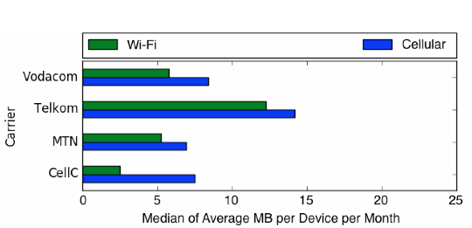
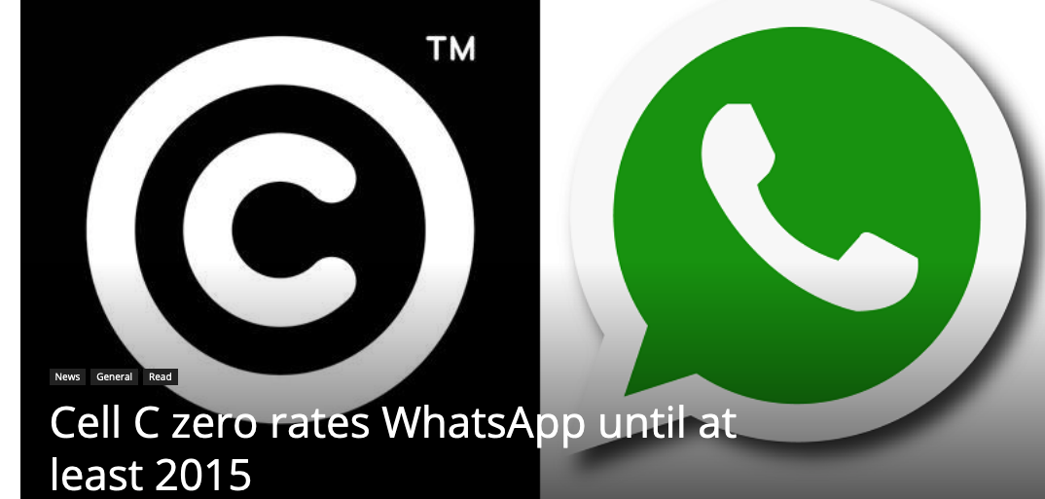
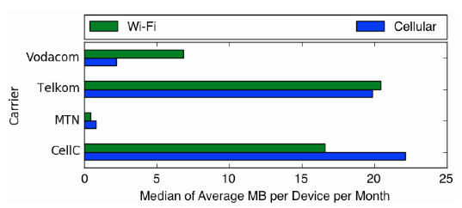
WhatsApp Usage: Effects of Zero Rating on Cell-C
Cellular usage of WhatsApp increased 3x on Cell-C during zero-rating period.
Other carriers usage also fluctuated for other carriers. Small N study (19 users total). May need more data to draw conclusions.
Notes:
Here we see WhatsApp's usage breakdown during Cell C's zero-rating period. Cell C usage has indeed shot up, with Wi-Fi usage increasing almost sevenfold to a median of around 17 MB of average monthly usage per device, and cellular usage increasing almost threefold to around 22 MB. This indicates that zero-rating WhatsApp may have had remarkable effects on its usage, greatly increasing the application's use not only on cellular connections (as was expected), but actually even more so on Wi-Fi connections. The fact that overall usage on Cell C seemed to increase so dramatically during this zero-rating period implies that perhaps WhatsApp became much more popular overall, regardless of connection type, because users felt they could use the app freely on any connection at no cost.
Oddly enough, we also see dramatic changes in WhatsApp usage for the other three carriers during this period. We found that the number of unique users on each carrier during this period may not be high enough to draw conclusive results, with only a handful of WhatsApp users on each carrier. 19 users total

Slide 8
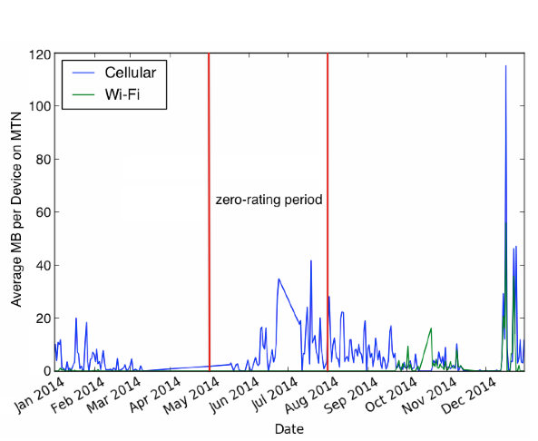
Effects of MTN’s Zero-Rating of Twitter During 2014 World Cup
Started during 2014 World Cup as promotion
Continued again later in 2014.
Recently discontinued in 2018.
Usage higher during and after initial zero-rating period.
Notes:
We know that MTN had a promotional event zero-rating Twitter from May through July 2014, delineated in the figure. Our results indicate much higher cellular usage in general than Wi-Fi usage throughout the year. The largest spike in both cellular and Wi-Fi data usage seems to correspond to the holiday season in December. This makes sense because social media platforms like Twitter are often used during holiday seasons for advertising and marketing.
The period from June to July shows the second most significant peak in cellular data usage. This perhaps indicates that MTN's promotional event zero-rating Twitter during this time period may have had some effect on user behavior. Cellular usage seemed to begin picking up around early June, reflecting a slight delay in user response to the zero-rating announcement. Usage peaked in mid-July, near the end of the event, before tapering back down throughout August and September. The fact that usage remained relatively high throughout the months immediately following the event implies that the promotion did seem to maintain some heightened level of interest and use in the application for a while, but by the end of the year cellular usage of the app had gone back down to pre-promotion levels seen at the beginning of the year. Thus, it seems that promotional events like zero-rating Twitter for a certain period of time may not have lasting effects on the app's popularity, though it may increase short-term usage during and immediately following the promotion.

Slide 9
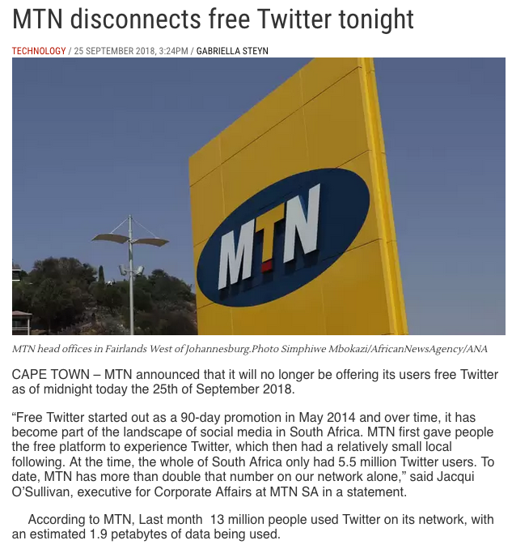
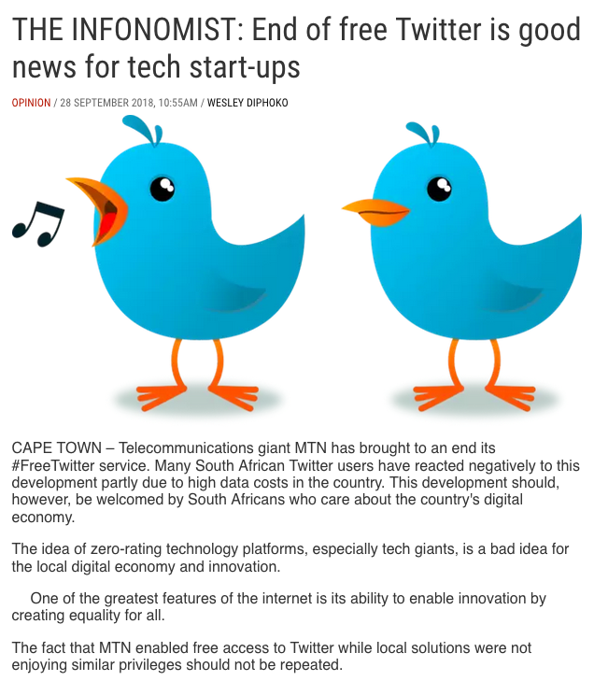
End of Free Twitter (2018)

Slide 10
Comparative Analysis: Surveys from Kenya And South Africa Reasons for using zero-rating
Notes:
116/1000 respondents used zero-rating – penetration is slow
The fact that 2/3 of those who had never used the Internet prior to using a zero-rating application now used paid plans provides evidence against the walled garden argument. Instead, what we see is zero-rated apps serving as a gateway, successfully introducing users to full unlimited Internet usage
Social networking and messaging dominate usage
Majority spend < 16 USD a month on mobile data

Slide 11
Comparative Analysis: Surveys from Kenya And South Africa Reasons for not using zero-rating
Notes:
116/1000 respondents used zero-rating – penetration is slow
The fact that 2/3 of those who had never used the Internet prior to using a zero-rating application now used paid plans provides evidence against the walled garden argument. Instead, what we see is zero-rated apps serving as a gateway, successfully introducing users to full unlimited Internet usage
Social networking and messaging dominate usage
Majority spend < 16 USD a month on mobile data

Slide 12
Zero Rating: Summary
Many users pay high prices for cellular data usage
Preference for Wi-Fi usage except Facebook was clear in studies
Zero rating affects usage, initially and over time
Overall usage of WhatsApp increases during a zero-rating period, regardless of connection type.
Twitter on MTN: increased usage of a zero-rated during and immediately following the zero-rating
Zero-rates is popular, both in Kenya and in South Africa
Zero-rating users prefer full-service applications on a paid plan to limited-service applications on a zero-rated plan.

